Slide 1

Genetics of Bacteria
2nd Year – 1st semester
Dr. Munira Ch. Ismail

Slide 2
Pathogenesis of the bacteria
Microbial pathogenicity has been defined as either the structural and biochemical mechanisms where by microorganisms can cause disease or the infectious process and mechanisms that's leading to the development of signs and symptoms of bacterial disease.
Pathogen: Microbe has ability to causing infection, some microbes are highly pathogenic, whereas others cause disease rarely (low pathogenic).
Virulence Gene: a gene whose presence or activity in an organism's genome is responsible forthe production of a virulence factor or part of a virulence pathway.
Infection: Multiplication of an infectious agent within the body. Multiplication of the bacteria that are part of the normal flora of the gastrointestinal tract, skin, and so on is generally not considered an infection; on the other hand, multiplication of pathogenic bacteria (eg, Salmonella species)—even if the person is asymptomatic—is deemed an infection.
Infection, in general, is the presence and multiplication of microbe within host.

Slide 3
Characters of pathogen:
Pathogenic organism should be able to enter the host body.
Pathogenic organism should be able to multiply in tissue.
Pathogenic organism should be able to damage the tissue.
They must be capable to resist the host defense.

Slide 4
Mechanisms of Bacterial Pathogenicity:
1. Invasiveness is the ability to invade tissues. It consists of colonization, production of extracellular substances which facilitate invasion and ability to by pass or overcome host defense mechanisms.
2.Toxigenesis is the ability to produce toxins. Bacteria may produce two types of toxins called exotoxins and endotoxins. Exotoxins are released from bacterial cells and may act at tissue sites removed from the site of bacterial growth. Endotoxins are cell-associated substance. The bacterial toxins, both soluble and cell-associated, may be transported by blood and lymph and cause cytotoxic effects at tissue sites remote from the original point of invasion or growth.

Slide 5
Factors that Influence the degree of Pathogenicity and the Progression of Infection and Disease
Host factors: Age, sex, ethnicity, nutrition (diet), hormonal status; personal hygiene and immune status; Underlying disease or medical condition; Antibiotic or drug usage; Presence of foreign object (e.g., splinter, catheter, sutures, etc.); Innate differences between hosts.
Microbial factors: Bacterial virulence factors; Inoculum size (dosage) External factors (e.g., crowding; seasonal variations; hygiene, sanitation and public health; food processing, storage and preparation; etc
Mucous membrane: is most common route for most pathogens. The mucous membranes are respiratory tract, gastrointestinal tract, urinary/genital tracts and conjunctiva. ⎫ Skin (keratinized cutaneous membrane):- Some pathogens infect hair follicles, sweat glands and colonize surface. But unless broken, skin is usually an impermeable barrier to microbes. ⎫ Parenteral route: - penetrate skin, punctures, injections, bites, cuts, surgery and deposit organisms directly into deeper tissues. The microbes must enter through preferred portal of entry in order to causedisease. But some can cause disease from many routes of entry.

Slide 6
Steps of initiation of infection or pathogenesis :
1- Transmission from an external source into the portal of entry:
The mode of transmission of many infectious diseases is :
Animal to animal which occurs either by direct contact such as sexual or indirect contact such as fecal oral.
Non animal source includes soil source, water source and insects.
Animal to human either directly such as cat scratch fever or via insects vector such as lyme disease.

Slide 7
2.Colonization (Adherence; Adhesion; Attachment):
Attachment/Adherence: Close association of bacterial cells and host cells generally characterized by receptors and target sites.
Surface Receptors/Target Sites: Receptor sites present on both hosts (Receptor) and bacterial surfaces (Adhesins).
Adhesins: Bind Specific Host Receptors often involve fimbriae as structural cell component; Host cell receptors are often sugar moieties. The lectins are adhesin specific for polysaccharide target receptor (sugar residues).
Fimbriae (plural): Short hair-like protein (pilin) appendages extending outward from the surface of certain bacteria.
Pili (plural); Pilus (singular): Short hair-like protein (pilin) appendages extending outward from the surface of certain bacteria and responsible for bacterial conjugation

Slide 8
Biofilms: - are formed when microbes adhere to a surface which usually moist and contains organic matter. The microbe secretes glycocalyx allowing other microbes to adhere a large mass is formed. The biofilms are resistant to disinfectants and antibiotics.

Slide 9
3.Invasiveness of the bacteria :
Is the ability of a pathogen to invade host tissues. Invasiveness encompasses
(1) mechanisms for colonization (adherence and initial multiplication),
(2) production of extracellular substances ("invasins"), that promote the immediate invasion of tissues and
(3) ability to bypass or overcome host defense mechanisms which facilitate the actual invasive process.

Slide 10
4.Toxigenesis :
Is the ability to produce toxins. Toxic substances produced by bacteria, both soluble and cell-associated, may be transported by blood and lymph and cause cytotoxic effects at tissue sites remote from the original point of invasion or growth.

Slide 11
5.Ability to evade host's immune system:
Pathogens have developed mechanisms to evade the phagocytes in the immune system by many ways such as grow in areas where there are no phagocytes, suppress the inflammatory response, inhibit phagocyte mobility, and "trick" the immune system into thinking the bacteria is a "self" cell.

Slide 12
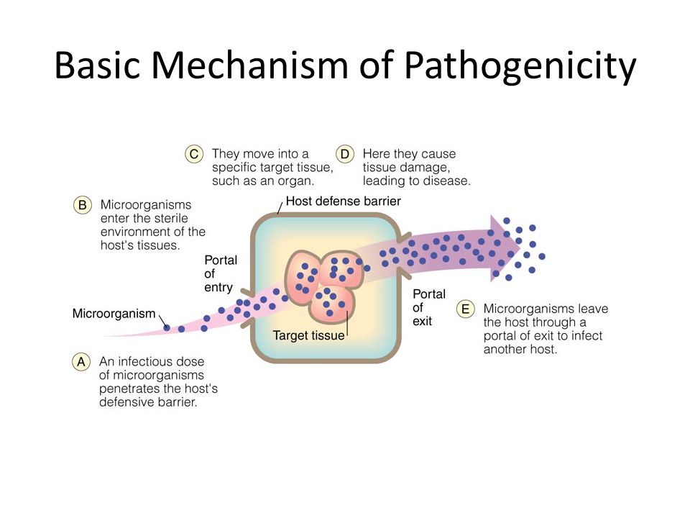

Slide 13
Numbers of Invading Microbes: -
The chances of causing diseases increase as the numbers of invading pathogens increases. This expressed by infectious dose (ID50) and lethal dose (LD50). The ID50 (Infectious Dose) is the number of microbes required to produce infection in 50% of the population. The ID50 is different for different pathogens i.e. different ID50 for different portals of entry for the same pathogen. The LD50 (Lethal Dose) amount of toxin or pathogen necessary to kill 50% of the population in a particular time frame.

Slide 14
Some important virulence factors that have a role in pathogenesis of bacteria:
A. Adherence Factors: Many pathogenic bacteria colonize mucosal sites by using pili (fimbriae) to adhere to cells.
A fimbriae is a hair like appendages ( short pilus) found on the surface of many bacteria, that is used to attach the bacterium to a surface. See the following figure:
B. Invasion Factors: Microbial invasion can be facilitated by virulence factors such as microbial adherence, resistance to antimicrobials, and defects in host defense mechanisms.
C. Capsules: Many bacteria are surrounded by capsules, it is a polysaccharide layer that lies outside the cell wall of bacteria. Capsule mediate adherence of pathogen to specific receptors on host cell surface. so that it prevent the phagocytes from adhering to bacteria, therefore act as antiphagocytic factor.
D. Enzymes: Several enzymes secreted by bacteria play a role in the pathogenesis of bacteria which facilitate local tissue damage such as ( protease, hyaluronidase, coagulase, elastase, ect.).

Slide 15
E. Toxins: Toxins produced by bacteria are generally classified into two groups:
1. Endotoxins: Integral part of the cell wall of gram - negative bacteria. Released on bacterial death and in part during growth such as polysaccharides of gram negative bacteria.
2. Exotoxins: Excreted by both gram - negative and gram positive bacteria. There are several types of protein toxins and enzymes produced and /or secreted from pathogenic bacteria. Major categories include cytotoxins, neurotoxins, and enterotoxins.
F. Siderophores: Siderophores are iron-binding factors that allow some bacteria to compete with the host for iron, which is bound to hemoglobin, transferrin, and lactoferrin such as P.aeruginosa.

Slide 16


